Slide 1
Edit Distance

Slide 2
How similar are two strings?
Spell correction
  The user typed “graffe”
Which is closest?
    graf
    graft
    grail
    giraffe
Computational Biology
  Align two sequences of nucleotides
  Resulting alignment:
AGGCTATCACCTGACCTCCAGGCCGATGCCC
TAGCTATCACGACCGCGGTCGATTTGCCCGAC
-AGGCTATCACCTGACCTCCAGGCCGA--TGCCC---
TAG-CTATCAC--GACCGC--GGTCGATTTGCCCGAC
Also for Machine Translation, Information Extraction, Speech Recognition

Slide 3
Edit Distance
The minimum edit distance between two strings
Is the minimum number of editing operations
  Insertion
  Deletion
  Substitution
Needed to transform one into the other

Slide 4
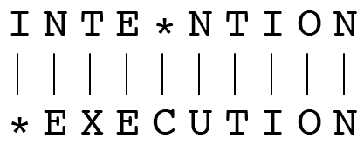
Minimum Edit Distance
Two strings and their alignment:

Slide 5
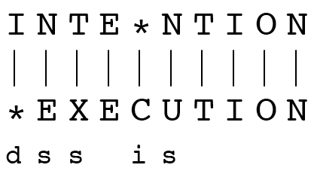
Minimum Edit Distance
If each operation has cost of 1
  Distance between these is 5
If substitutions cost 2 (Levenshtein)
  Distance between them is 8

Slide 6
Alignment in Computational Biology
Given a sequence of bases
An alignment:
Given two sequences, align each letter to a letter or gap
AGGCTATCACCTGACCTCCAGGCCGATGCCC
TAGCTATCACGACCGCGGTCGATTTGCCCGAC
-AGGCTATCACCTGACCTCCAGGCCGA--TGCCC---
TAG-CTATCAC--GACCGC--GGTCGATTTGCCCGAC

Slide 7
Uses of Edit Distance in NLP
Evaluating Machine Translation and speech recognition
R Spokesman confirms senior government adviser was appointed
H Spokesman said the senior adviser was appointed
S I D I

Slide 8
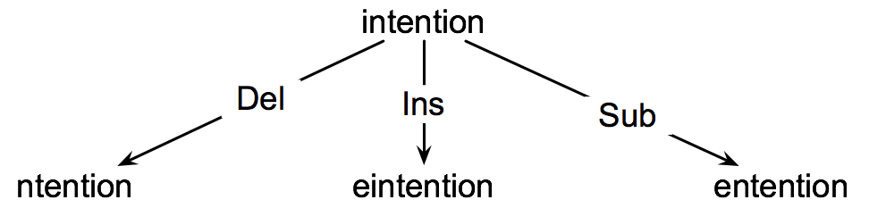
How to find the Min Edit Distance?
Searching for a path (sequence of edits) from the start string to the final string:
  Initial state: the word we’re transforming
  Operators: insert, delete, substitute
  Goal state: the word we’re trying to get to
  Path cost: what we want to minimize: the number of edits

Slide 9
Minimum Edit Distance as Search
But the space of all edit sequences is huge!
  We can’t afford to navigate naïvely
  Lots of distinct paths wind up at the same state.
    We don’t have to keep track of all of them
Instead, we use dynamic programming, in a way very similar to the LCS problem…

Slide 10
Defining Edit Distance Parameters
For two strings
  X of length n
  Y of length m
We define D(i,j)
  the edit distance between X[1..i] and Y[1..j]
    i.e., the first i characters of X and the first j characters of Y
  The edit distance between X and Y is thus D(n,m)

Slide 11
Dynamic Programming for Edit Distance
Dynamic programming: A tabular computation of D(n,m)
Solving problems by combining solutions to subproblems.
Bottom-up
  We compute D(i,j) for small i,j
  And compute larger D(i,j) based on previously computed smaller values
  i.e., compute D(i,j) for all i (0 < i < n) and j (0 < j < m)

Slide 12
Defining Min Edit Distance (Levenshtein)
Initialization
D(i,0) = i
D(0,j) = j
Recurrence Relation:
For each i = 1…M
For each j = 1…N
D(i-1,j) + 1
D(i,j)= min D(i,j-1) + 1
D(i-1,j-1) + 2; if X(i) ≠ Y(j)
0; if X(i) = Y(j)
Termination:
D(N,M) is distance

Slide 13
The Edit Distance Table
N | 9
O | 8
I | 7
T | 6
N | 5
E | 4
T | 3
N | 2
I | 1
# | 0 | 1 | 2 | 3 | 4 | 5 | 6 | 7 | 8 | 9
 | # | E | X | E | C | U | T | I | O | N

Slide 14
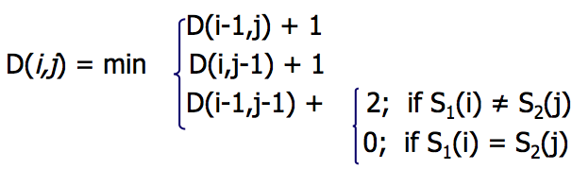
The Edit Distance Table
N | 9
O | 8
I | 7
T | 6
N | 5
E | 4
T | 3
N | 2
I | 1
# | 0 | 1 | 2 | 3 | 4 | 5 | 6 | 7 | 8 | 9
 | # | E | X | E | C | U | T | I | O | N

Slide 15
Edit Distance
N | 9
O | 8
I | 7
T | 6
N | 5
E | 4
T | 3
N | 2
I | 1
# | 0 | 1 | 2 | 3 | 4 | 5 | 6 | 7 | 8 | 9
 | # | E | X | E | C | U | T | I | O | N

Slide 16
The Edit Distance Table
N | 9 | 8 | 9 | 10 | 11 | 12 | 11 | 10 | 9 | 8
O | 8 | 7 | 8 | 9 | 10 | 11 | 10 | 9 | 8 | 9
I | 7 | 6 | 7 | 8 | 9 | 10 | 9 | 8 | 9 | 10
T | 6 | 5 | 6 | 7 | 8 | 9 | 8 | 9 | 10 | 11
N | 5 | 4 | 5 | 6 | 7 | 8 | 9 | 10 | 11 | 10
E | 4 | 3 | 4 | 5 | 6 | 7 | 8 | 9 | 10 | 9
T | 3 | 4 | 5 | 6 | 7 | 8 | 7 | 8 | 9 | 8
N | 2 | 3 | 4 | 5 | 6 | 7 | 8 | 7 | 8 | 7
I | 1 | 2 | 3 | 4 | 5 | 6 | 7 | 6 | 7 | 8
# | 0 | 1 | 2 | 3 | 4 | 5 | 6 | 7 | 8 | 9
 | # | E | X | E | C | U | T | I | O | N

Slide 17
Computing alignments
Edit distance isn’t sufficient
  We often need to align each character of the two strings to each other
We do this by keeping a “backtrace”
Every time we enter a cell, remember where we came from
When we reach the end,
  Trace back the path from the upper right corner to read off the alignment

Slide 18
Edit Distance
N | 9
O | 8
I | 7
T | 6
N | 5
E | 4
T | 3
N | 2
I | 1
# | 0 | 1 | 2 | 3 | 4 | 5 | 6 | 7 | 8 | 9
 | # | E | X | E | C | U | T | I | O | N

Slide 19
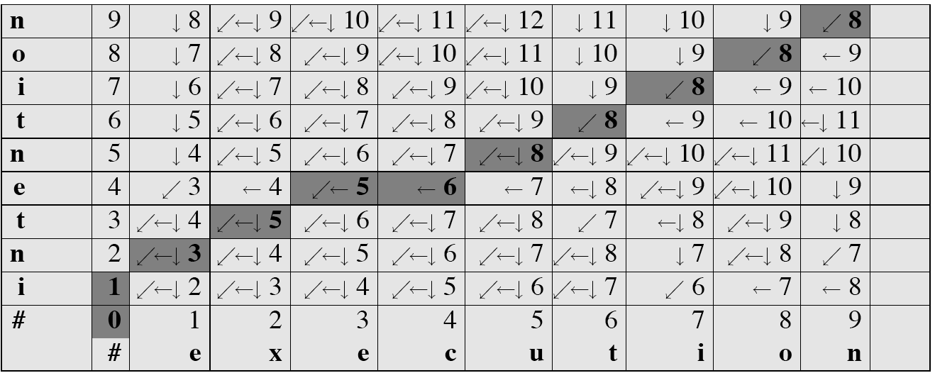
MinEdit with Backtrace

Slide 20
Adding Backtrace to Minimum Edit Distance
Base conditions: Termination:
D(i,0) = i D(0,j) = j D(N,M) is distance
Recurrence Relation:
For each i = 1…M
For each j = 1…N
D(i-1,j) + 1
D(i,j)= min D(i,j-1) + 1
D(i-1,j-1) + 2; if X(i) ≠ Y(j)
0; if X(i) = Y(j)
LEFT
ptr(i,j)= DOWN
DIAG
deletion
insertion
substitution
insertion
deletion
substitution

Slide 21
Performance
Time:
O(nm)
Space:
O(nm)
  Can be improved to O(n+m) using Hirschberg’s algorithm
Backtrace:
O(n+m)

Slide 22
Types of Edit Distance Metrics
The Levenshtein distance allows deletion, insertion and substitution.
The Longest common subsequence (LCS) distance allows only insertion and deletion, not substitution.
The Hamming distance allows only substitution; hence, it only applies to strings of the same length.
The Damerau–Levenshtein distance allows insertion, deletion, substitution, and the transposition of two adjacent characters.
The Jaro distance allows only transposition.

Slide 23
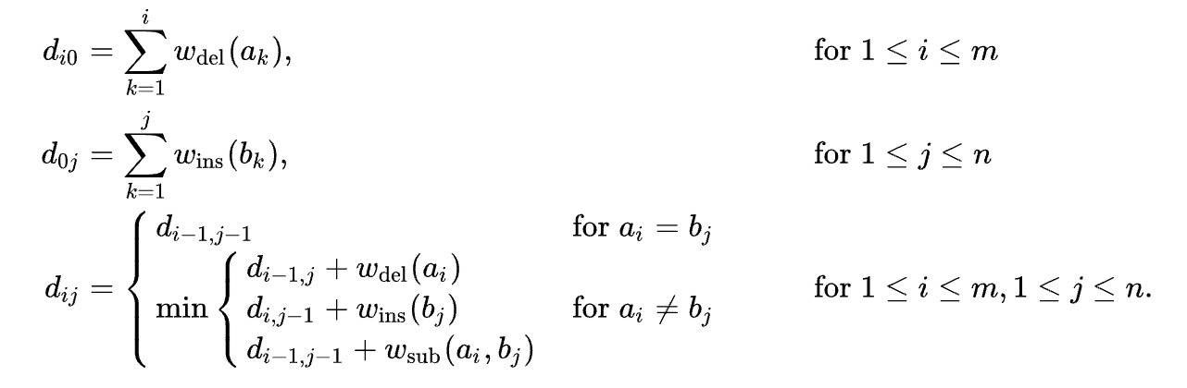
Common Algorithm
This doesn’t include transposition – how could we add this operation?

